Slide 1
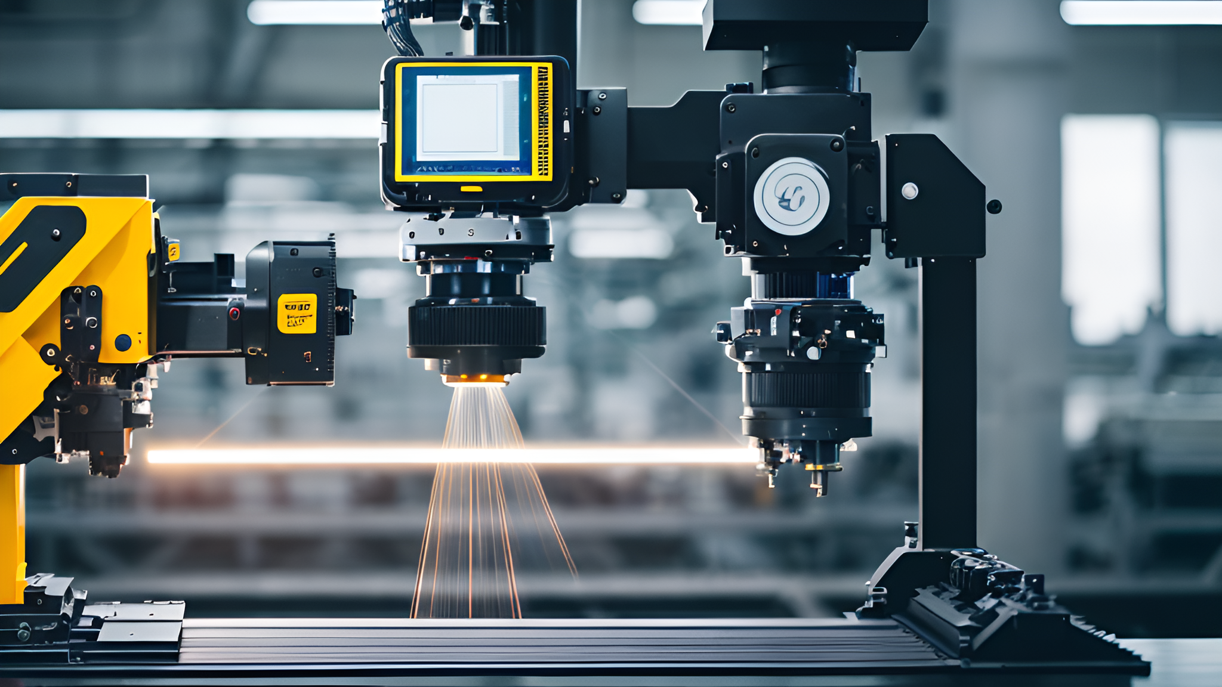
What’s Next in Contract Manufacturing? Key Trends to Watch in 2024
In the rapidly evolving world of contract manufacturing, staying ahead of industry trends is crucial for maintaining a competitive edge. As we look towards 2024, several key trends are set to shape the future of contract manufacturing. From the integration of advanced technologies like AI and robotics to advancements in supply chain management and the growing demand for customizable solutions, these trends are transforming the landscape of manufacturing. In this post, we explore these upcoming trends and their potential impact on the industry.

Slide 2
What’s Next in Contract Manufacturing? Key Trends to Watch in 2024
In the rapidly evolving world of contract manufacturing, staying ahead of industry trends is crucial for maintaining a competitive edge. As we look towards 2024, several key trends are set to shape the future of contract manufacturing. From the integration of advanced technologies like AI and robotics to advancements in supply chain management and the growing demand for customizable solutions, these trends are transforming the landscape of manufacturing. In this post, we explore these upcoming trends and their potential impact on the industry.

Slide 3

Integration of AI and Robotics
AI-Driven Manufacturing Processes
Artificial Intelligence (AI) is revolutionizing contract manufacturing by enhancing process efficiency, reducing errors, and improving product quality. AI algorithms can analyze vast amounts of data to optimize production schedules, predict maintenance needs, and streamline quality control.
Robotics in Manufacturing
Robotics are becoming increasingly integral to contract manufacturing, particularly in repetitive and precision-driven tasks. Advanced robots are capable of performing complex operations with high accuracy and speed, leading to increased productivity and reduced labor costs.
Collaborative Robots (Cobots)
Cobots are designed to work alongside human workers, enhancing their capabilities and ensuring safety. These robots are equipped with sensors and AI to adapt to human actions, making them ideal for tasks that require human dexterity and machine precision.

Slide 4
Flair-Plastic has recently integrated robotics-driven systems into our plastic injection molding processes. This advanced technology utilizes robotic systems for various tasks such as part insertion/extraction, degating, trimming, cutting, and secondary operations like loading inserts and quality control checks. By automating these processes, we have significantly reduced manual labor, minimized errors, and enhanced production efficiency.
The implementation of robotics has allowed us to reduce our defect rate by 20%, improve product consistency, and increase overall production efficiency by 15%. These robots handle repetitive and injury-prone tasks with precision, ensuring high-quality output and consistent production cycles. Additionally, robotics have streamlined our operations, enabling our skilled workforce to focus on more complex and value-added tasks, leading to faster production times and quicker delivery to our customers.
Example:
Robotics have also been instrumental in post-processing tasks such as assembly, packaging, and palletizing. Their ability to perform delicate assembly operations and precise dispensing has further enhanced our productivity and quality assurance. As a result, Flair-Plastic has strengthened its reputation for reliability and excellence in the plastic injection molding industry.

Slide 5


Real-Time Data Analytics
The use of real-time data analytics in supply chain management is transforming how manufacturers track and manage their inventory. By leveraging big data, manufacturers can make informed decisions, anticipate demand fluctuations, and reduce lead times.
Advancements in Supply Chain Management
Blockchain Technology
Blockchain technology offers enhanced transparency and security in supply chains. By providing a decentralized ledger of all transactions, blockchain ensures that every step of the manufacturing process is traceable, reducing the risk of fraud and errors.
Internet of Things (IoT) Integration
IoT devices enable seamless communication between machinery, products, and logistics systems. This connectivity allows for real-time monitoring and optimization of the supply chain, resulting in more efficient operations and reduced costs.

Slide 6






In the plastic injection molding industry, IoT-enabled sensors are transforming manufacturing processes through real-time monitoring and predictive maintenance.
IoT sensors monitor raw material usage and production output in real-time. This continuous data stream allows precise inventory management, reducing stockouts and overstocking, leading to a 15% reduction in inventory holding costs.
Use Case: Real-Time Monitoring and Inventory Management
Sensors track machine performance indicators like vibrations and temperature to predict maintenance needs. This reduces unplanned downtime, extends machinery lifespan, and maintains consistent product quality.
Example:
Use Case: Predictive Maintenance
By monitoring the injection molding process, IoT sensors detect defects early, allowing for immediate adjustments. This ensures final products meet quality standards, reducing waste and boosting customer satisfaction.
Use Case: Enhanced Quality Control
For more insights into IoT applications in manufacturing, explore Digi International and MachineMetrics.

Slide 7
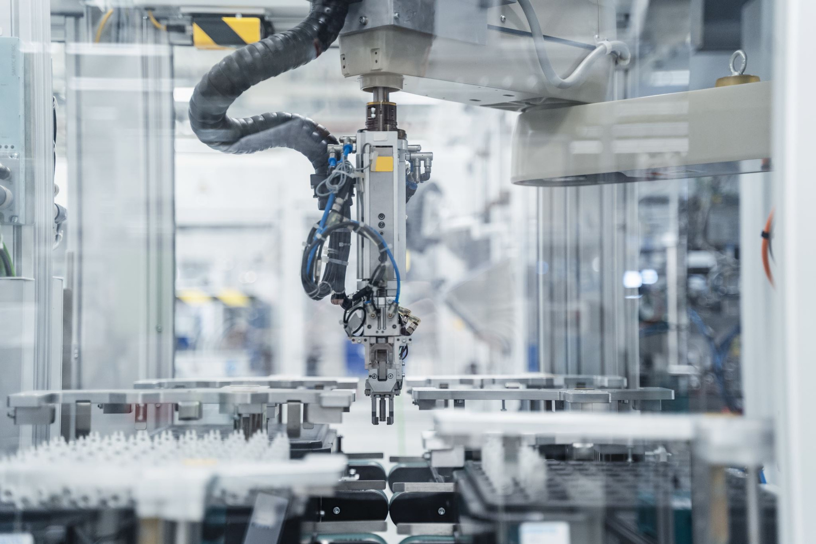
Demand for Customization
Consumers and businesses are increasingly seeking personalized products tailored to their specific needs. This trend is driving manufacturers to adopt flexible production systems that can accommodate small batch sizes and rapid design changes.
Shift Towards Customizable Manufacturing Solutions
Additive Manufacturing (3D Printing)
Additive manufacturing technologies, such as 3D printing, are enabling manufacturers to produce customized components with minimal lead times. This technology is particularly beneficial for prototyping and small-scale production runs.
Agile Manufacturing Practices
Agile manufacturing emphasizes flexibility and responsiveness to changing market demands. By adopting agile practices, manufacturers can quickly adjust their production processes to meet customer requirements and reduce time-to-market.

Slide 8
As we advance into 2024, the landscape of contract manufacturing is poised for significant evolution, driven by rapid technological advancements and shifting market dynamics. The integration of AI and robotics is revolutionizing production processes, enhancing precision, and optimizing efficiency. These technologies enable predictive maintenance, real-time quality control, and seamless human-machine collaboration, thereby reducing downtime and operational costs.
Moreover, advancements in supply chain management are setting new standards for transparency and efficiency. The adoption of blockchain technology ensures traceability and security in transactions, while IoT devices facilitate real-time tracking and data analytics, enabling manufacturers to respond swiftly to market changes and demand fluctuations. These innovations not only streamline operations but also enhance decision-making capabilities and customer satisfaction.
Additionally, the shift towards customizable manufacturing solutions is redefining industry standards. With the growing demand for personalized products, manufacturers are adopting flexible production systems and advanced technologies such as 3D printing and AI-driven design interfaces. This shift allows for greater product variety, faster prototyping, and reduced time-to-market, catering to the evolving preferences of consumers.
By staying abreast of these transformative trends, manufacturers can significantly enhance their operational capabilities, improve efficiency, and effectively meet the diverse and changing needs of their customers. Embracing these advancements will not only provide a competitive edge but also pave the way for sustained growth and innovation in the contract manufacturing sector.
Looking Ahead

Slide 9

For businesses looking to leverage these trends, Flair-Plastic offers state-of-the-art contract manufacturing services that incorporate the latest technologies and practices. Contact us today to learn how we can help you stay ahead in this dynamic industry.

